Slide 1
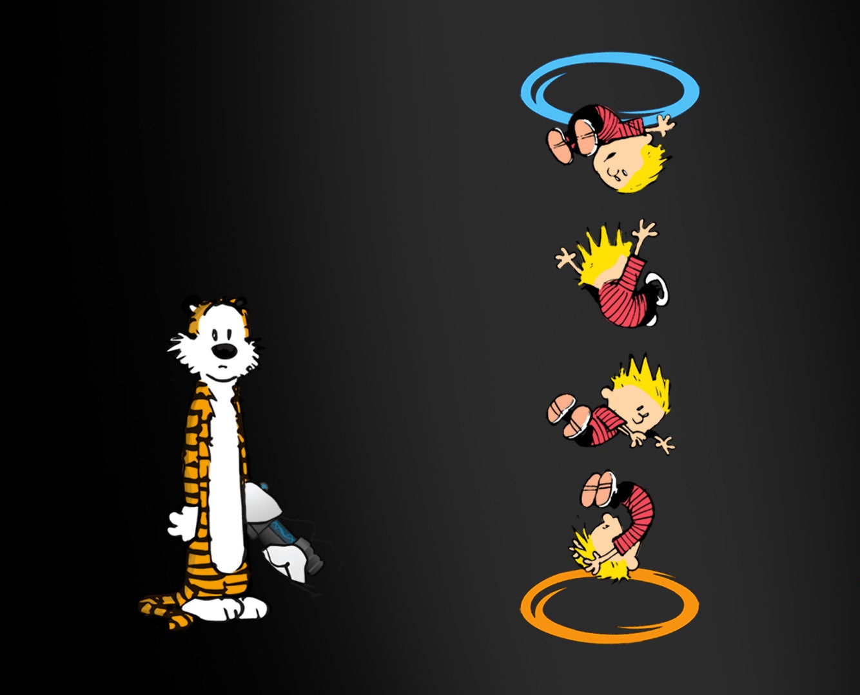
To Discover or Create, Software Engineering vs. Computer Science
ERWC Module 7 Multi-Genre Portfolio Presentation
Presented by:
DeAndre Baldwin

Slide 2

I’m confused on the difference between being a computer scientist or software engineer, which field is the best for me?
With over 90 million high demand positions opening for computer specialists by 2020, which computer field should you specialize in?

Slide 3

Narrative Song Lyrics
I once was a kid, all I had was a dream
Do what my dad did, and become a Marine.
When I was seventeen, I was living the dream
Had my own room, own phone, own car, man, how'd I get this far?
Then one day when I was home alone, I got a call on the phone, it turned out to be Staff Sergeant Thibodeux
He talked to me about what I wanted to be and if I wanted to join the mighty Army, I was just like man, that ain't me.
Then a ring came from Staff Sergeant Irish, asking me about my wish of joining the Corps, that's when I realized my heart wasn't in it anymore.
Man, summer was a bummer, sitting at home trying to think my life over
What else could I be, when my whole life was aimed at the military?
Then it came to me, why not enter the computer industry?
With my knowledge high, motivation on the fly, grades on point, I knew it couldn't disappoint.
Now here I am, at age eighteen, once again reliving the dream. With my goals on track, it was time to attack. Filling out college apps, while completing placement tasks, it was time to raise a glass, on track at last, but I have one last task,
I gotta pass this class, or they wont accept my *explicit*.
These lyrics were specifically made for anyone interested on how I reverted from being hardcore Marine Corps to a Computer Specialist and why.
Construction of these lyrics followed a strict complex rhyme scheme, with all verses being in chronological order. Lots of teens nowadays are trying out rapping, mainly freestyling, so getting readers should not be a problem
In order to construct a complex rhyme, you need to have multiple couplets, tercets, or even sextets, that follow a strict AAAA, AABA, etc. rhyme scheme. That’s it!

Slide 4

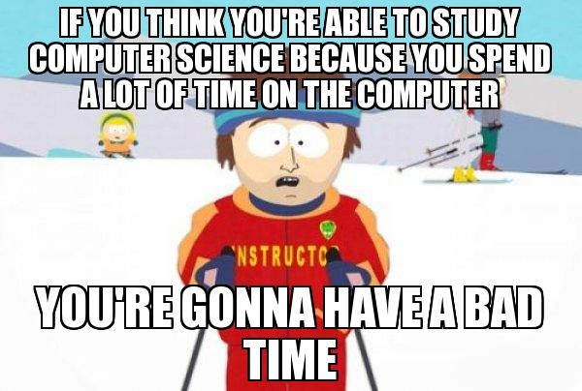
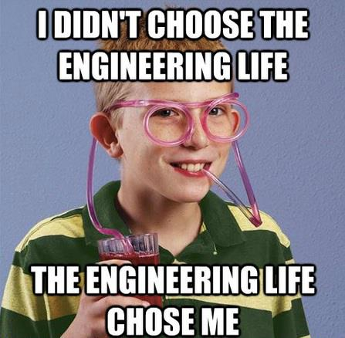
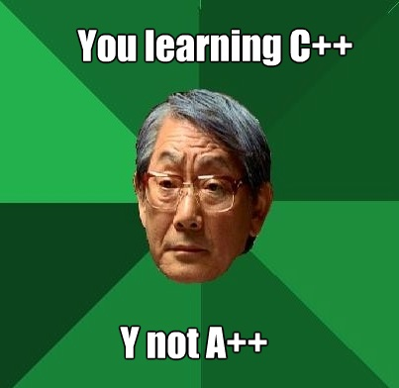
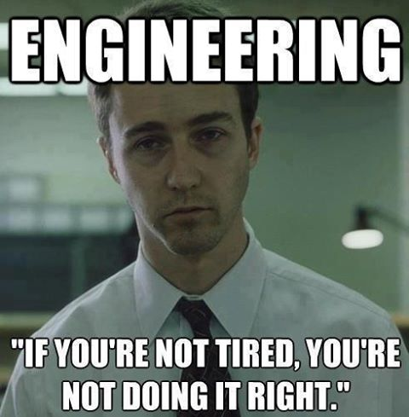
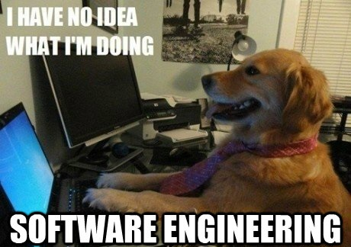
MEMESMEMESMEMESMEMESMEMESMEMESMEMESMEMESMEMESMEMESMEMESMEMESMEMESMEMESMEMESMEMESMEMEMES
With memes being popular on every corner of the internet, why not take the opportunity to contribute some that will be viewed by thousands of browsers?
With memes, effectiveness is variable and entirely dependent on the creators. Do you want to be witty, condescending, funny, or just be informational? Doesn’t matter fam.
These memes relate to the daily thoughts and feelings of software engineers and computer scientists, along with the complications faced.

Slide 5


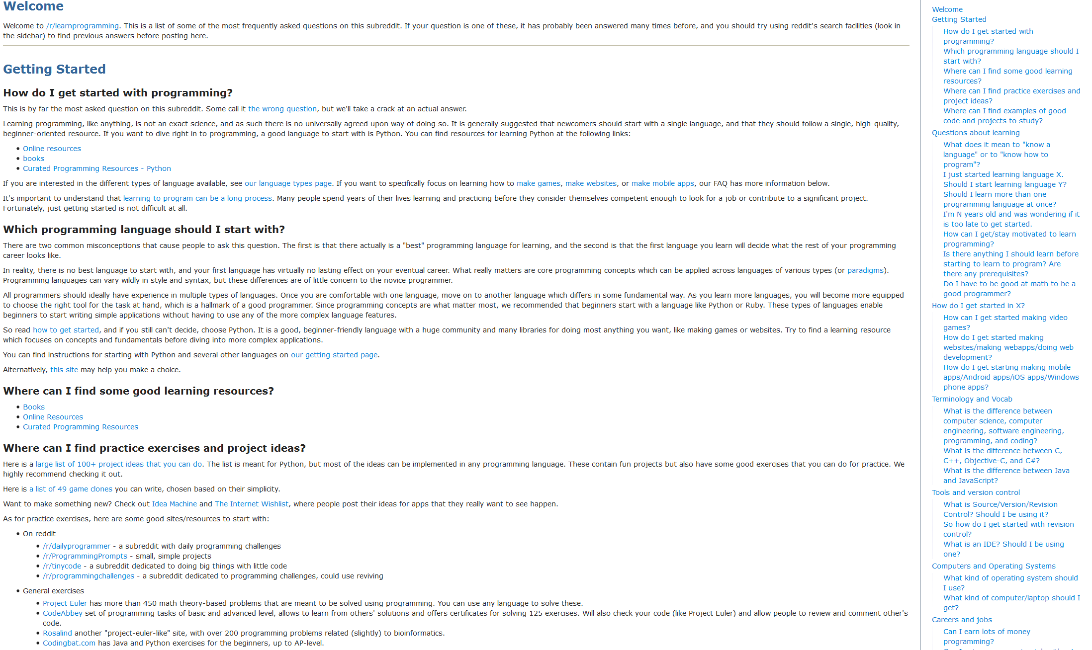
Reddit Post
Anyone interested in programming will find this subreddit FAQ very useful as it provides links and other resources in order for you to learn and refine programming skills, basic and advanced.
If you’re interested you can just search for /r/learnprogramming
Here, you can also find users, just like you, that are interested in the computer science/engineering field.

Slide 6

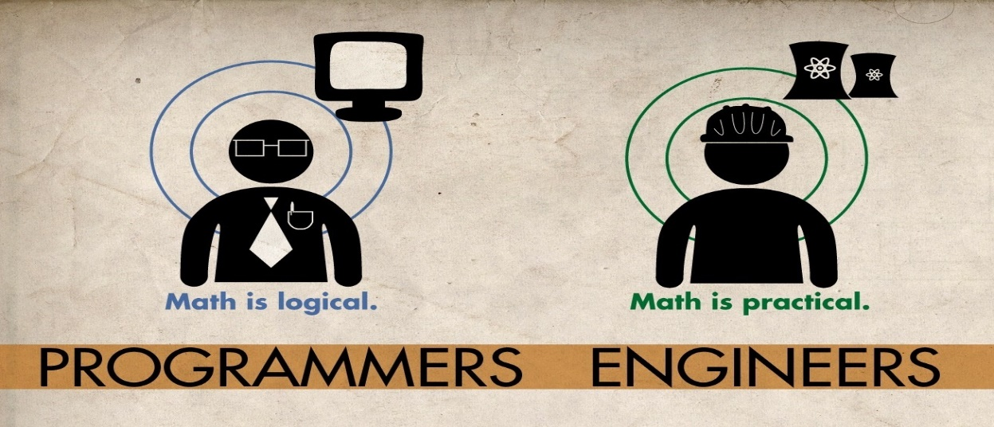
Okay… So I still don’t know what the difference between Computer Science and Software Engineering is…
If you are still interested in these fields of study, the breakdown can’t get any more simpler than this. You must choose wisely as this is your money and future.
You may see that there is a significant difference between the two. If you are comfortable and proficient in math, I would look into the Computer Science field. If you prefer working in groups on large projects while learning on the job, look into Software Engineering.
Computer Scientists build in order to learn. Scientists focus on understanding, designing, and developing programs and computers. At its core, Computer Science concentrates on data, data transformation, and algorithms.
Software Engineers learn in order to build. Engineers deal with building and maintaining software systems. It is more software-oriented and has a greater emphasis on large software applications and the entire software development process, from idea to final product.

Slide 7


And in conclusion…
I have learned that planning your future is essential for lifetime happiness and success. You have to thoroughly plan and set milestones for yourself. Do what you love, you don’t want any ordinary job, you want a career that you want to show up for everyday.
So no más for this guy
Along with that, for my new found career, I discovered the differences between being an engineer and scientist within the computer tech field. I even found information on how to gain advantages over candidates for employment.

Slide 8

Works Cited Akhauri, Amitabh. "Demand for Software Engineers in the Manufacturing Sector to Rise - The Economic Times." The Economic Times. Economic Times, 8 Jan. 2014. Web. 23 Jan. 2015. Erickson, Jon. "Hacking, 2nd Edition." Google Books. N.p., Feb. 2008. Web. 23 Jan. 2015. Guzdial, Mark, and Philip Guo. "The Difficulty of Teaching Programming Languages, and the Benefits of Hands-on Learning." Communications of the ACM 57.7 (2014): 10. Web. 23 Jan. 2015. Lutz, Michael J., J. Fernando Naveda, and James R. Vallino. "Undergraduate Software Engineering." Communications of the ACM 57.8 (2014): 52. Web. 23 Jan. 2015. Tamburri, Damian A., Patricia Lago, and Hans VAN VLIET. "Organizational Social Structures for Software Engineering." ACM Computing Surveys 46.1 (2013): 3. Web. 23 Jan. 2015.

Slide 9
